Slide 1
Investor’s Dream 3.0
Fintech - Project 3
Group 1 Collaborators:
Julian Ritchey
John Yin
Andrea Delgadillo Tomasevich
Dmitry Chalganov
Wanlin Li
Presentation Date: August 03, 2023

Slide 2
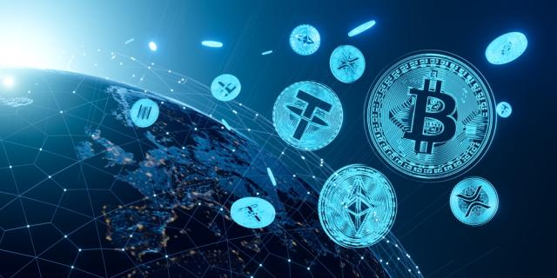
Purpose of the Project
Create an easy to use predictive trading product and monetize it.

Slide 3

Important Questions
How can an application draw in first-time investors?
What are the potential returns to the customer?
How can an application improve portfolio performance?
How can an application monetize its features/services?
How can an application facilitate fee transactions for features/services?
How can the product be delivered to the customers?

Slide 4
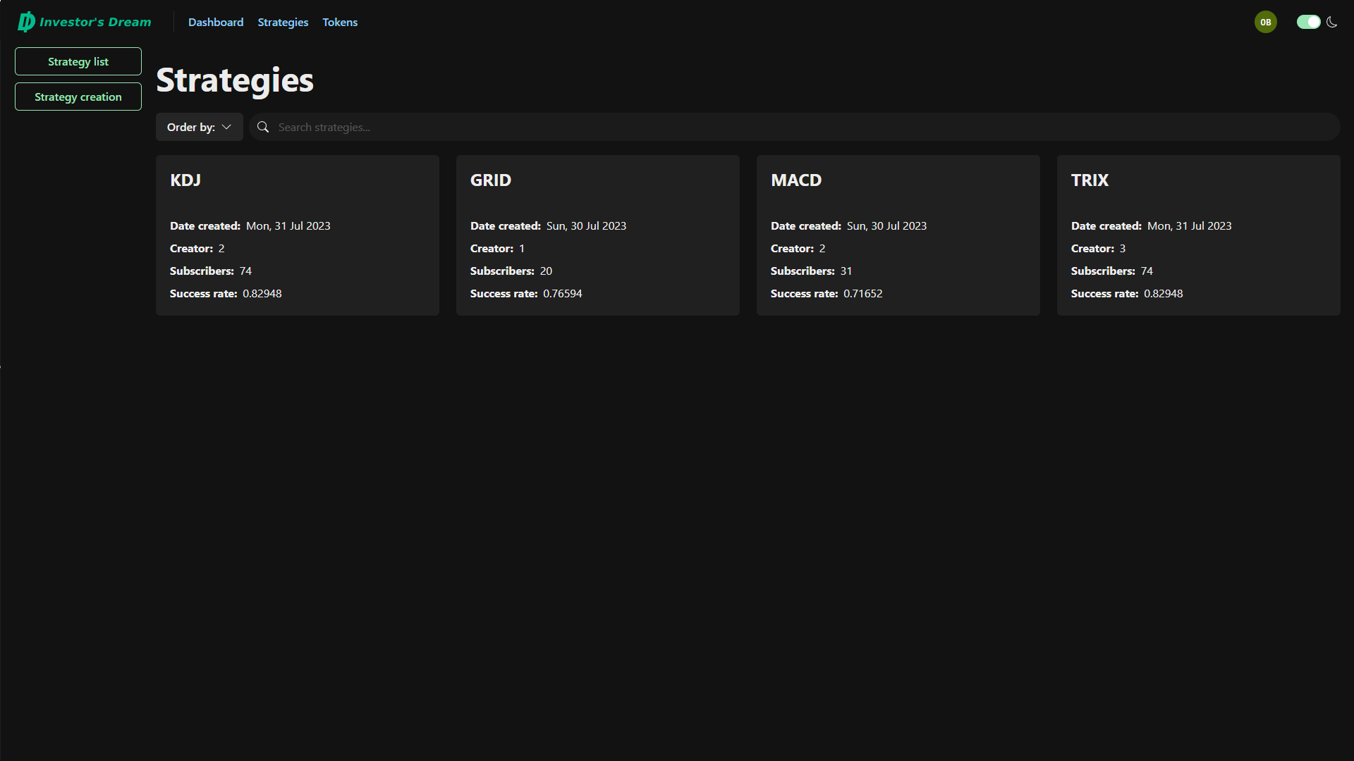
How can an application draw in first-time investors?
The new investors can develop and test their strategies for free.

Slide 5
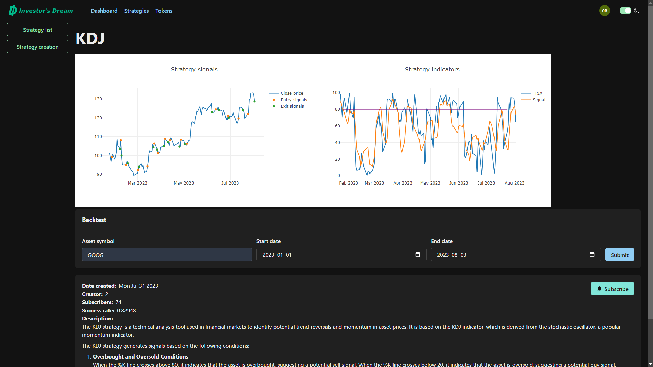
What are the potential returns for the customer?
The strategies in our product are back-tested through algorithmic trading models.

Slide 6
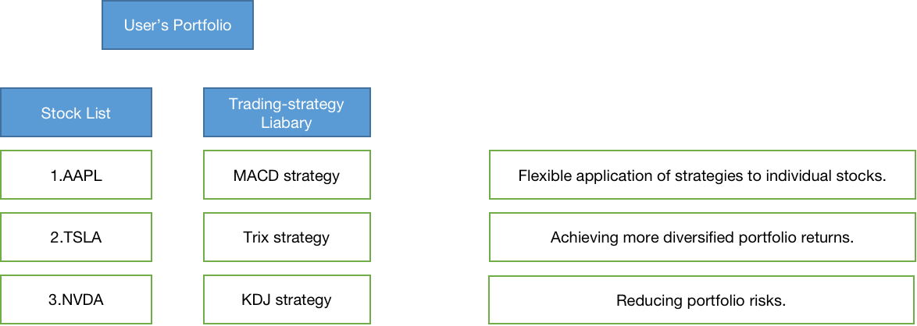

How can an application improve portfolio performance?
In a stock portfolio, users can test different algorithmic trading strategies for each stock. This will help the users choose which strategy works the best.

Slide 7
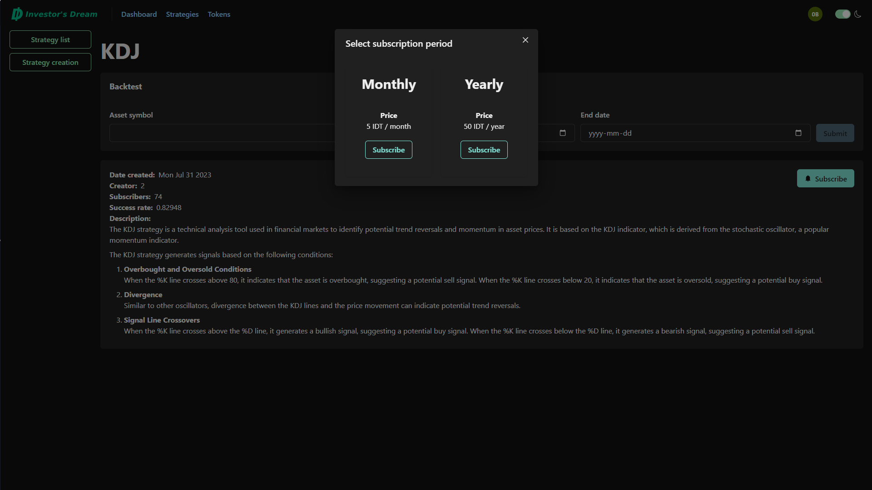
How can an application monetize its features/services?
The trading strategies will be available for a subscription fee.

Slide 8
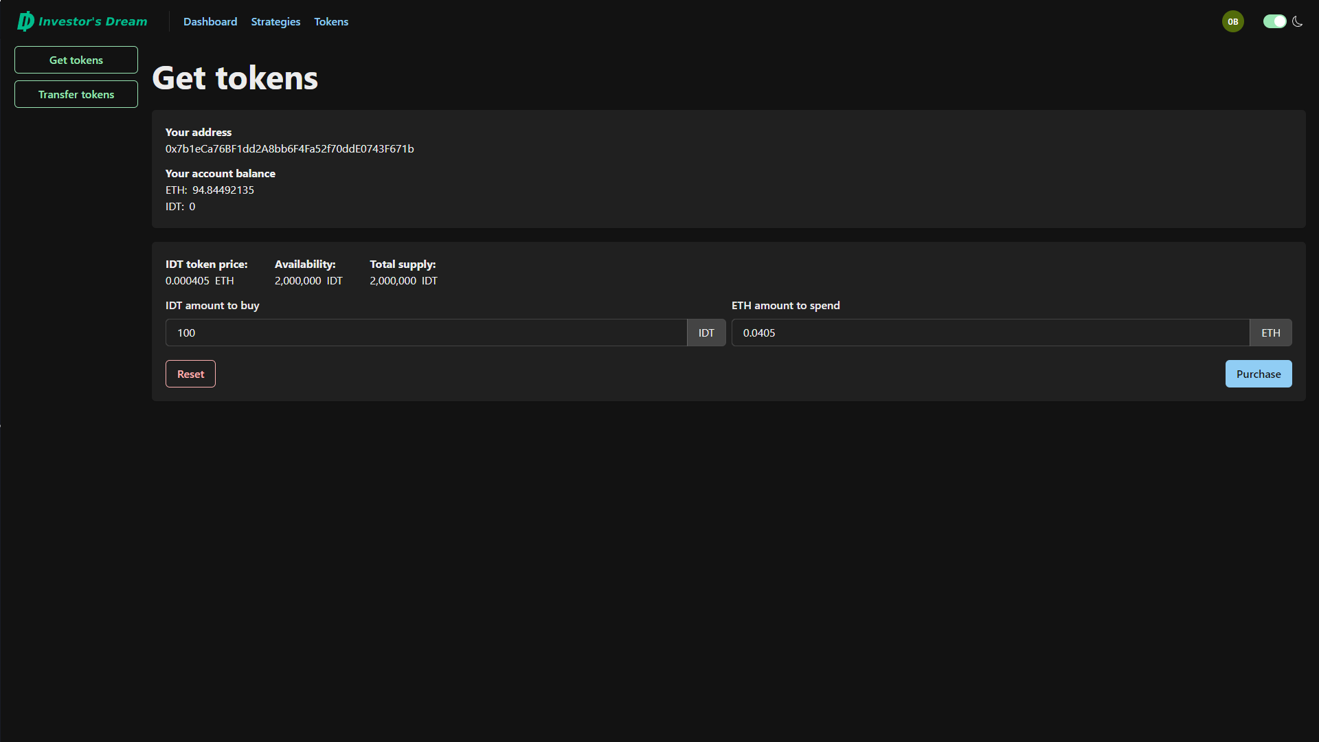
How can an application facilitate fee transactions for features/services?
The minted tokens on the blockchain will be available for purchase by the users to spend on the application’s services.

Slide 9
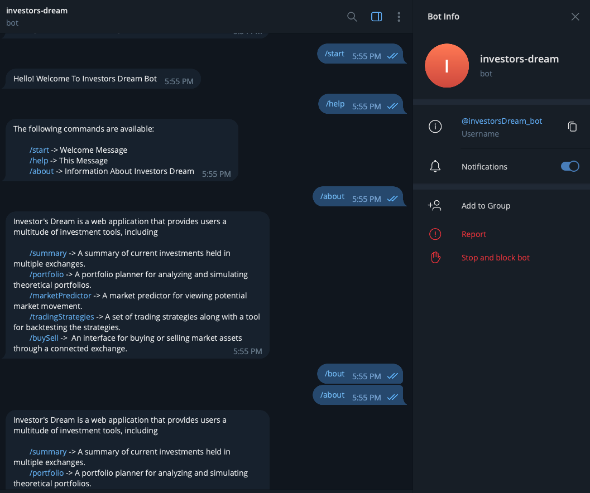
How can the product be delivered to the customers?
The users will get buy/sell signals in telegram after subscribing to the services.

Slide 10
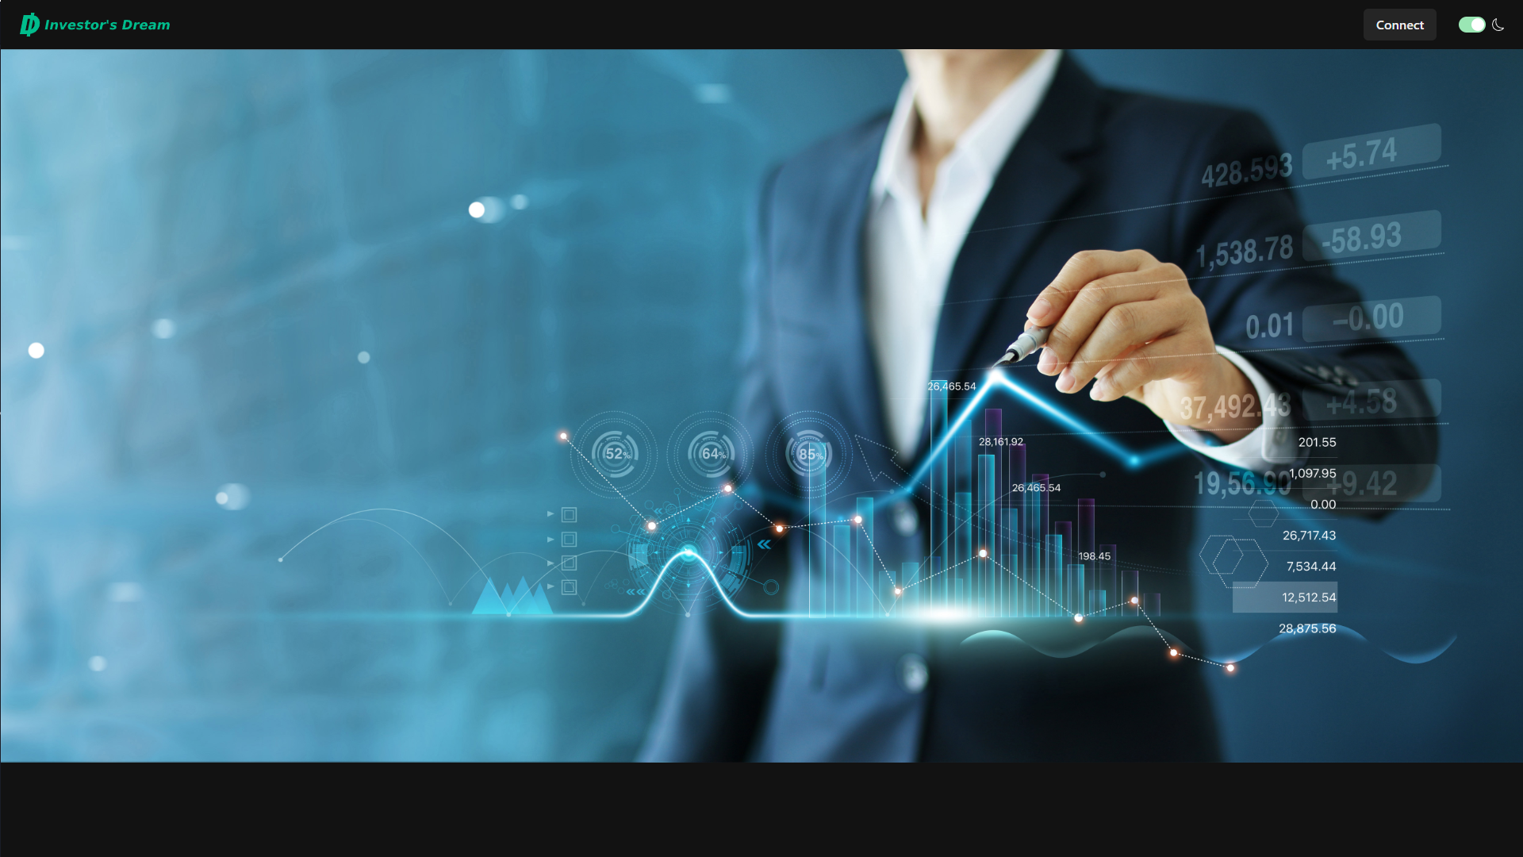
Investor’s Dream 3.0

Slide 11
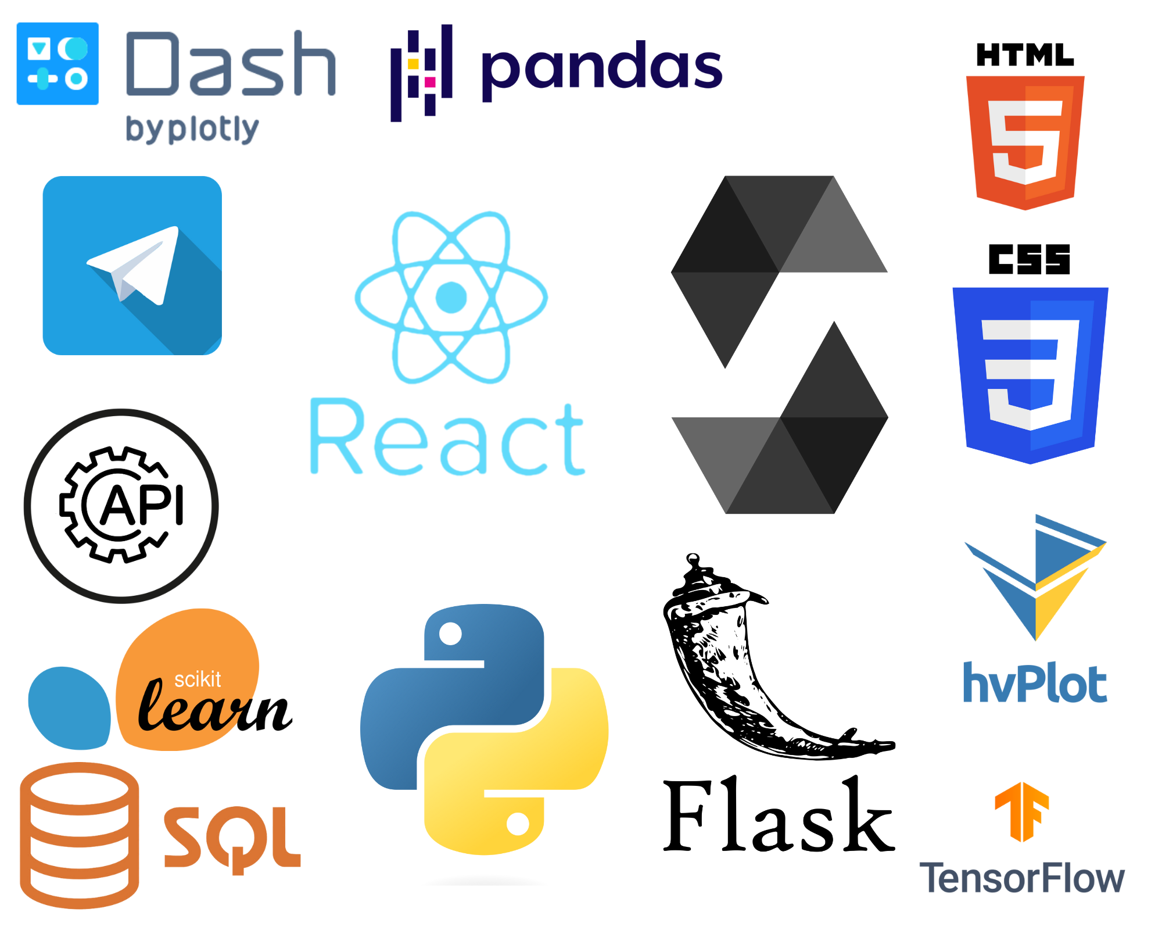
What technology was used?
Python (main programming language)
Flask
API calls
Tensor Flow
Scikit-Learn
JavaScript
React
Web3
TypeScript
Solidity
SQL
HTML
CSS
Bots (Discord, Telegram)

Slide 12
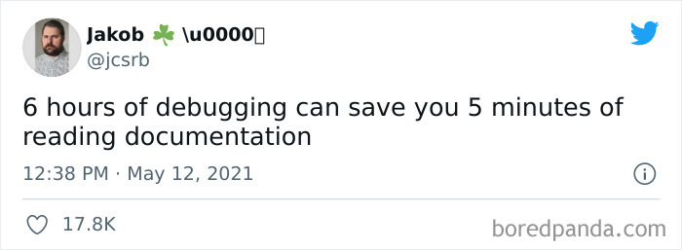
Project Difficulties
Learning a new language/library - React (JavaScript & Typescript)
Developing an API to transfer information between frontend server and backend server
Investigating API interactions - Discord, Facebook, Telegram, Twilio (SMS, WhatsApp)
Integrating separate developers’ code
Tweaking trading strategy models and developing new models - Low timeframes
Creating new functions for blockchain contracts - Subscriptions

Slide 13
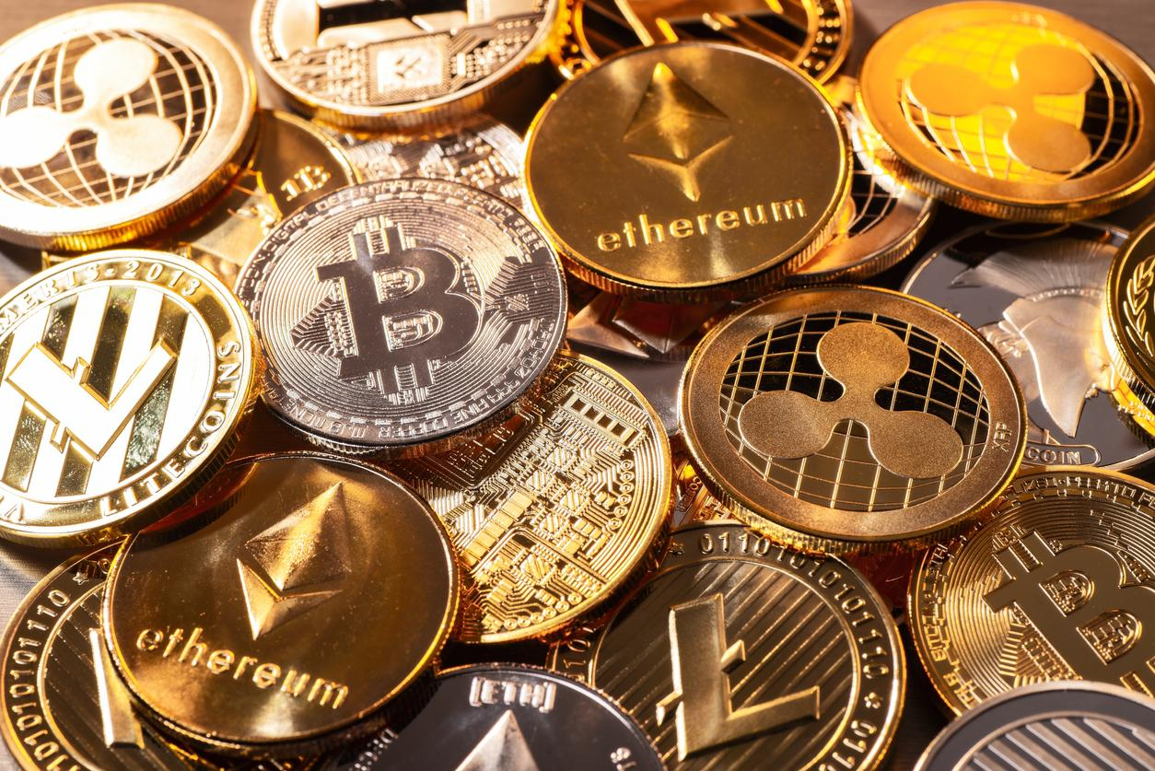
Thank you for your attention!

